Slide 1
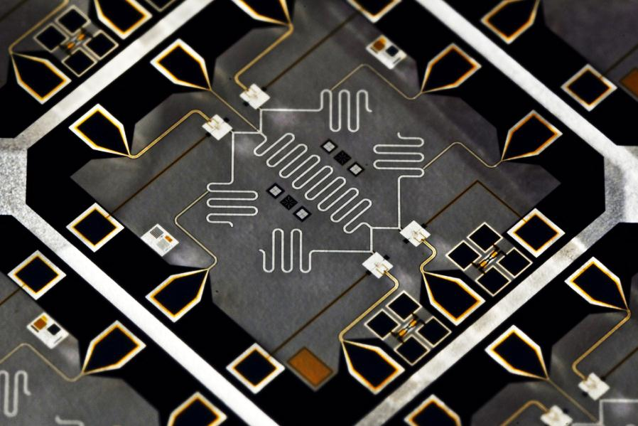
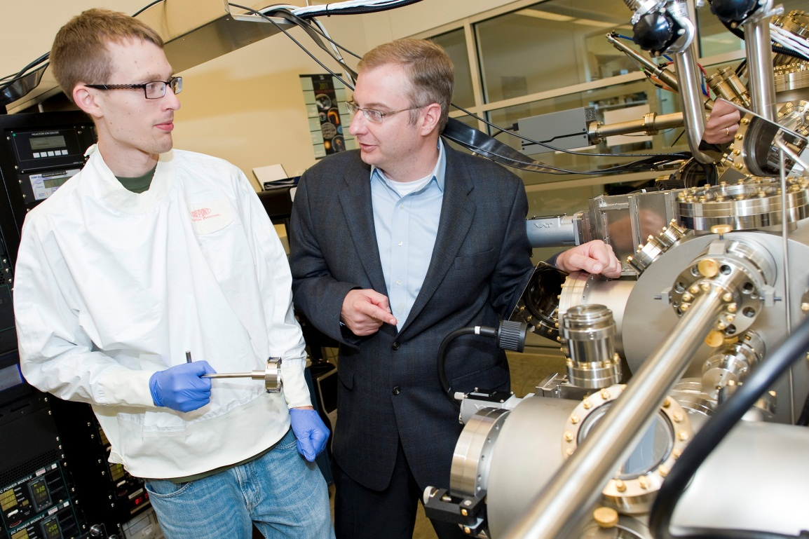
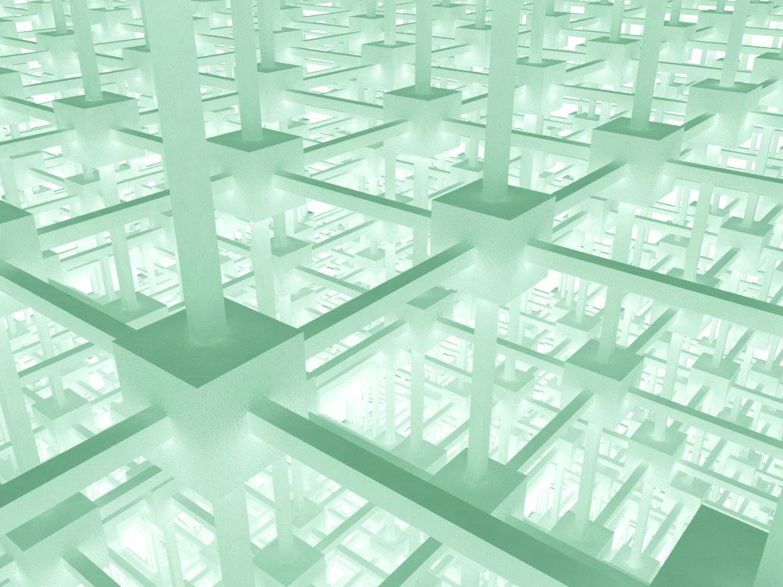
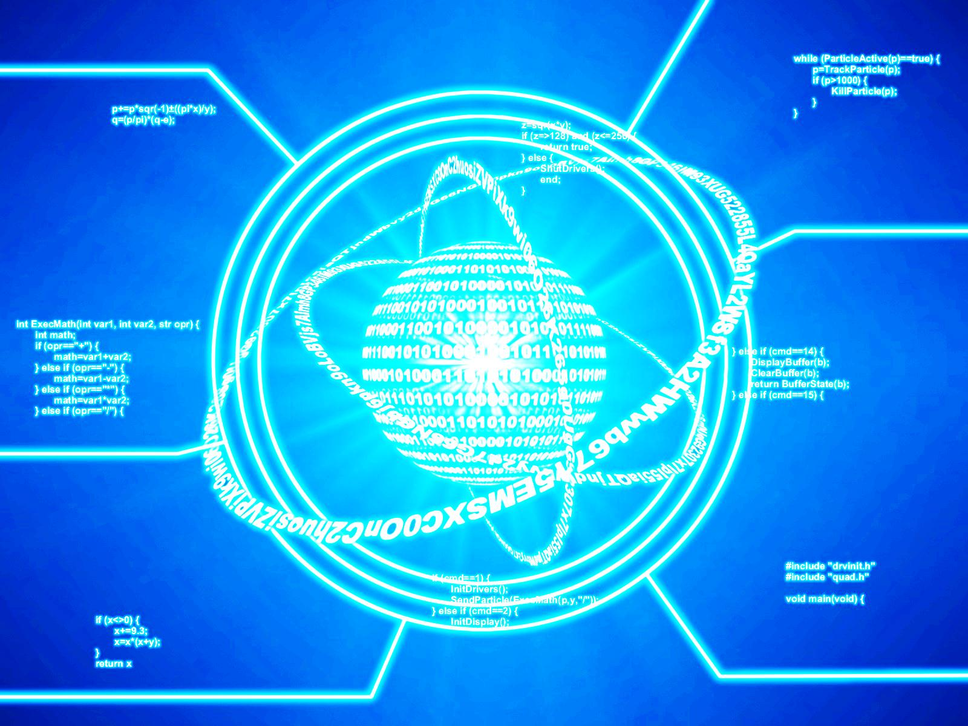
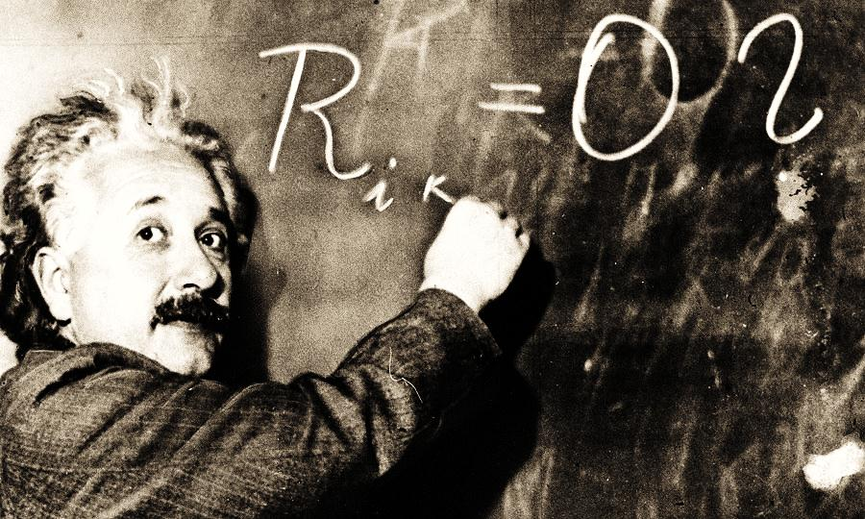


Post-Quantum Cryptography
Computer Security Division &
Applied and Computational Mathematics Division
Overview
Lattice-based Cryptography
Standardization Timeline
Potential threat posed by quantum computers
  Shor's algorithm breaks cryptosystems based on factoring and discrete logs (e.g., RSA, Diffie-Hellman, DSA over finite fields, elliptic curve)
  Could quantum computers solve other hard problems?
  Will large-scale quantum computers ever exist?
    Recent estimates of fifteen to twenty years
Post-quantum cryptosystems
  Based on lattices, codes, multivariate quadratic equations
  Public-key cryptosystems (encryption, key establishment, digital signatures)
NTRUEncrypt: seems pretty good (fast, has reasonable key sizes, security is related to problems involving ideal lattices)
NTRUSign: was broken in the past, has been patched, seems ok now?
Theoretical work: cryptosystems and signature schemes with provable security based on the worst-case hardness of problems involving (ideal) lattices
  Supports the design of NTRUEncrypt, but suggests modifications to NTRUSign (which would make it less efficient)
Questions: Can we get better lattice-based signatures?
  Can we get reliable, quantitative estimates of security?
    Performance of lattice basis reduction algorithms?
  Are ideal lattices any less secure than general lattices?
NIST is calling for quantum-resistant cryptographic algorithms for new public-key crypto standards
  Digital Signatures, and Encryption/Key-establishment
July 2016 – Draft Call For Proposals released for public comment
Nov 2016 – Formal Call For Proposals finalized
Nov 2017 – Deadline for PQC submissions
April 2018 - Workshop
3-5 years – Analysis/Evaluation phase
2 years later – Draft Standards ready (2023-2025)
Quantum Computation
McEliece and Code-based Cryptosystems
Evaluation Criteria
Quantum algorithms
  Quantum computers achieve exponential speedups on certain problems (e.g., hidden subgroup problems)
  And polynomial speedups on many more problems (esp. oracle problems, e.g., Grover search, element distinctness)
  Could there be more exponential speedups?
Large-scale quantum computers
  Fault-tolerant quantum computation is possible in theory
  But current experimental implementations still have difficulty in achieving low error rates, and scaling up to large numbers of qubits
  Need to move from individual components to complete systems
  Need a lot of gates and qubits to beat a classical computer (b/c of fault tolerance overhead, and b/c today's classical computers are so good)
Based on the hardness of decoding random linear codes
McEliece cryptosystem
  Well-studied, and seems very secure, but has giant keys
  Can we live with giant keys?
Newer schemes
  Reduce the key size by adding more structure
  But security is not as well understood? (e.g., attacks using Grobner basis algorithms)
Questions: Can we develop more efficient and secure signature schemes than the CFS signature scheme?
Security
  Security definitions (IND-CCA2, EUF-CMA, CK)
  Quantum/classical algorithm complexity
  Security proofs
Cost
  Computational efficiency (hardware/software)
  Memory requirements (parameter and key sizes)
Algorithm and implementation characteristics
  Ease of implementation on variety of platforms
  Parallelizable, resistant to side-channel attack
  How does it fit into exsisting protocols (e.g. TLS, IKE)
Multivariate Cryptosystems
Alternate Directions
Based on the hardness of solving random systems of multivariate quadratic equations with respect to the isomorphism of polynomials problem
Build a system of equations that contains a “trapdoor”
  Small-field schemes (e.g., unbalanced oil-vinegar)
  Big-field schemes (e.g., HFE-, pSFLASH)
Caution: several schemes have been broken using differential attacks (e.g., SFLASH)
Questions: Can we develop a framework for useful security arguments?
  Can we develop efficient and secure encryption schemes?
Hash-based signature schemes
  Lamport-Merkle
    Well-studied
    Security relies on one-way function (e.g. hash function)
    Based on one time signatures and Merkle trees
Isogeny based cryptosystems
  Security relies on computing isogenies between supersingular elliptic curves
  Newer proposal, not yet well-studied
Questions: Is it possible to reduce the signature size of Lamport-Merkle?
Research
Y. K. Liu, Privacy Amplification in the Isolated Qubits Model
Y.K. Liu, Tamper-Resistant Cryptographic Hardware in the Isolated Qubits Model
R. Perlner, Optimizing Information Set Decoding Algorithms to Attack Cyclosymmetric MDPC codes
R. Perlner, D. Moody, Vulnerabilities of “McEliece in the World of Escher”
R. Perlner, D. Smith-Tone, Security Analysis and Key Modification for ZHFE
R. Perlner, D. Moody, D. Smith-Tone, Attack on the Cubic ABC Simple Matrix Multivariate Encryption Scheme
D. Smith-Tone, R. Cartor, R. Gipson, On the Differential Security of the HFEv- Signature Primitive
pqc@nist.gov

